Slide 1

An Analysis on The Differences between Casul Riders and Members of Cyclistic

Slide 2
Agenda
1
2
3
4
5
Business Objective of This Analysis
Explanation of Process of Analysis
Results of Analysis
Insights Gained
Recommended Actions

Slide 3

Business Objective
The objective of pursuing this analysis was to find the differences between casual riders of Cyclistic and the annual paying members, and subsequently use these findings to find out the reasons for casual riders converting into members. These findings would be used to target digital media marketing campaign to increase the number of annual paying members of Cyclistic.

Slide 4
How Data was Processed and Analyzed
I took the ridership data from divvy for the full year of 2024. I then processed this data in MySQL to update the null values, check the data types, check for bad records and made a master table containing the full year’s data that was homogenized.
Only the first 5 months had date and time data (DD-MM-YYYY : HH:MM:SS), whereas the rest only had time data in the format of MM:SS. Due to more than half the data having only the time data, I opted to format the rest of the data in the same way as well. This would however mean that I could not perform analysis on the relationships of time of day and day of week amongst the different rider types which would have probably proved useful.

Slide 5
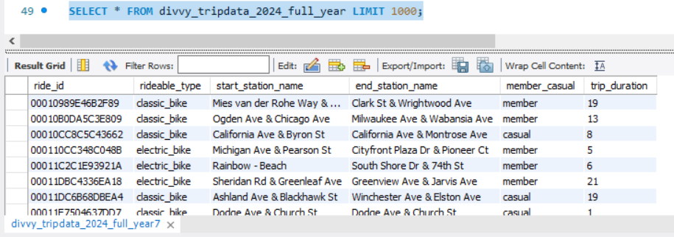
How Data was Processed and Analyzed
I finally added a column showing the trip duration in minutes (assuming that the trip is under an hour, due to the nature of the data, I cannot determine if it is over an hour).
This is what the final data looked like:

Slide 6

Results of Analysis
I used R to perform analysis as it is an opensource tool that is very effective at handling large data like this project (which ended up at close to 4.3 million rows of data).
It is also easy to track the analysis and repeat steps with variations if required at any time as the steps are all saved as a source file.
All analysis was done using the tidyverse library in R (specifically ggplot2 and dplyr for the majority).

Slide 7
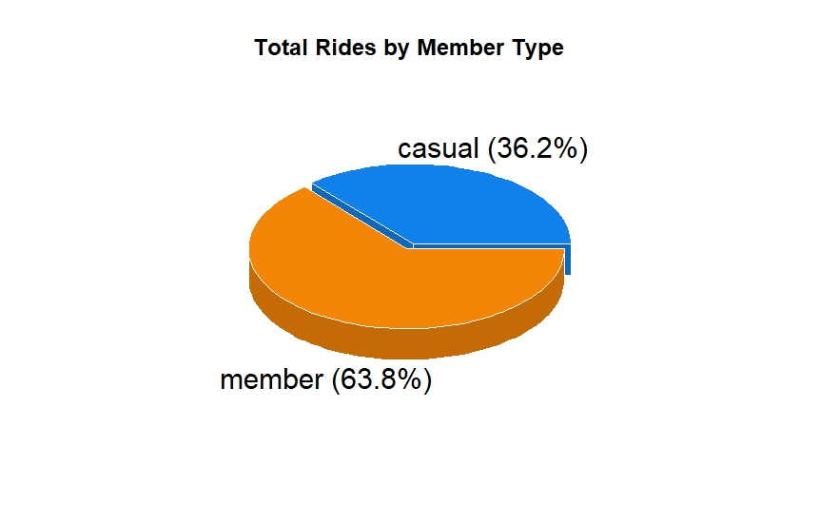
Analysis of Rider Types in Different Categories
An overall analysis of the rider types who use Cyclistic shows that the majority are already annual subscribers.

Slide 8
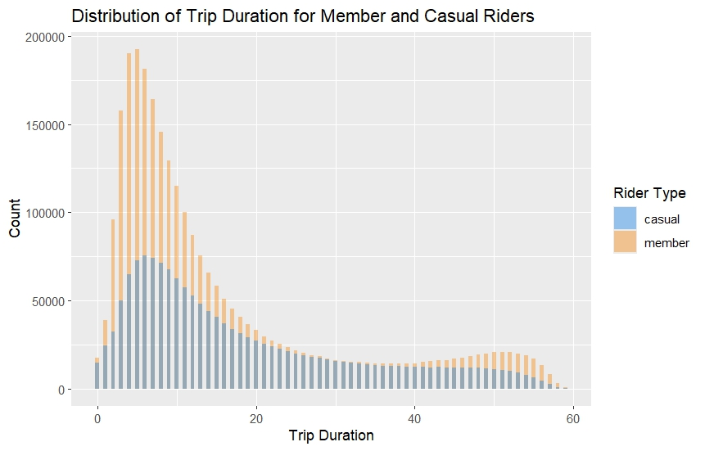
Analysis of Rider Types in Different Categories
Looking into the distribution of how each type of user uses the service, we find that they are very similar, indicating the similarity between how both users use the service.

Slide 9
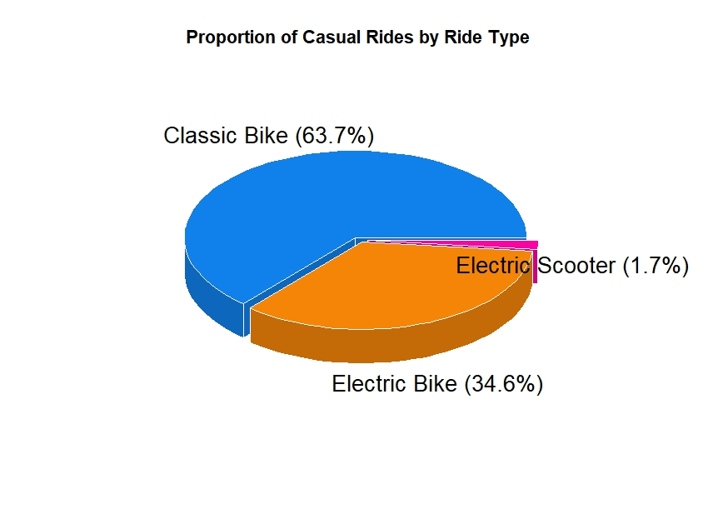
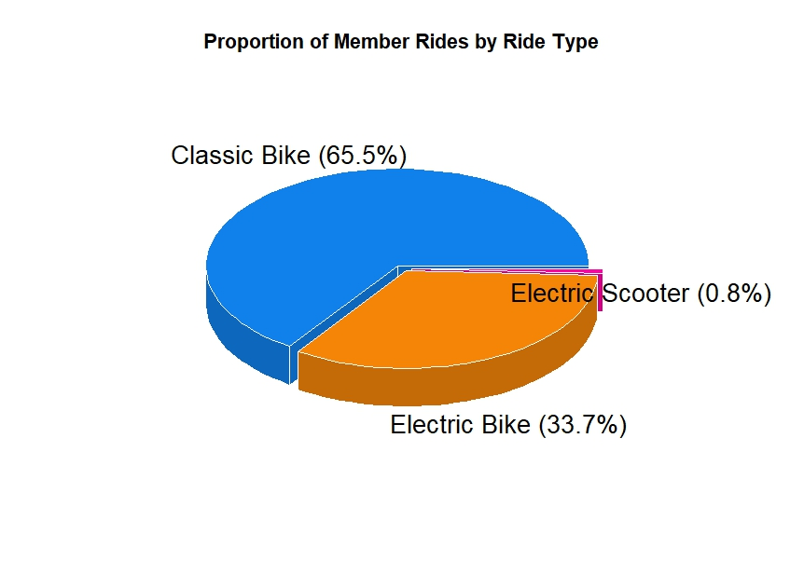
Analysis of Rider Types in Different Categories
If you were to look at even how each user uses the different types of rides offered, it is a similar story.

Slide 10
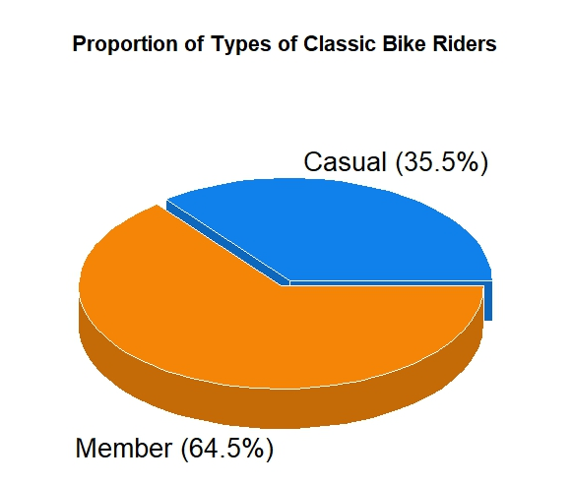
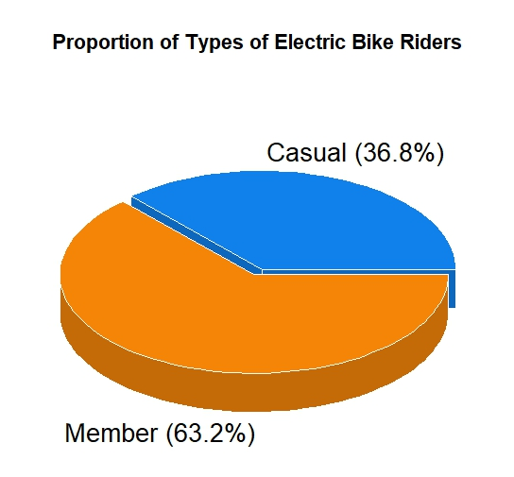
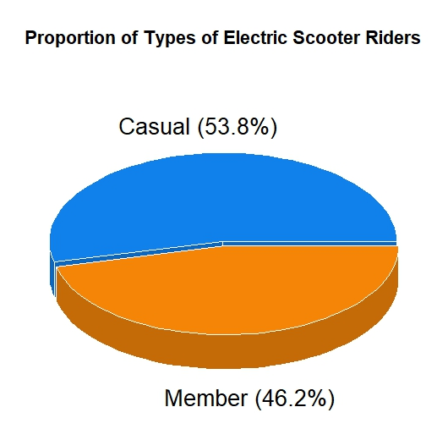
Analysis of Rider Types in Different Categories
Analyzing the ridership type for each type of ride, shows that the majority of users are indeed members (which is to be expected as they are the majority of overall rides). However, the exception to this is in the usage of electric scooters which is interesting to note.

Slide 11
Analysis of Rider Types in Different Categories
The difference between casual riders and members was the most apparent in how the most popular routes are used. The majority of the top 10, top 15 and even top 20 routes show that there is an overwhelming majority of casual riders who use those routes. Indicating that the majority of casual riders only use a few select routes.

Slide 12
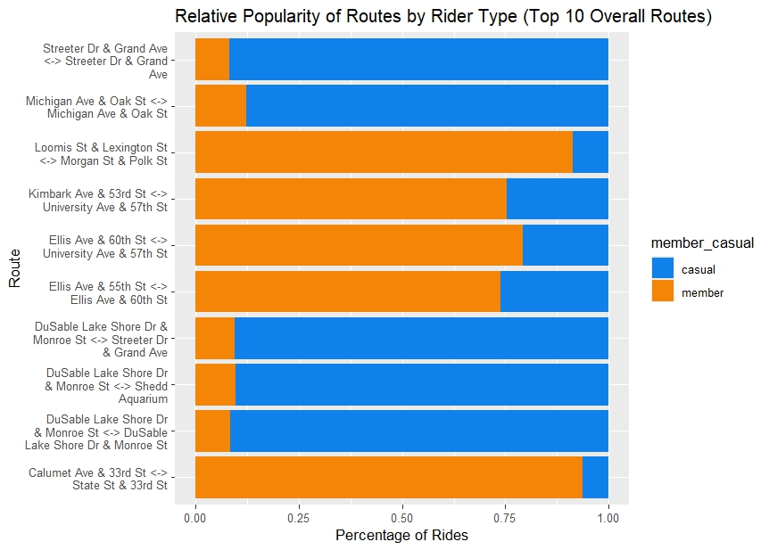
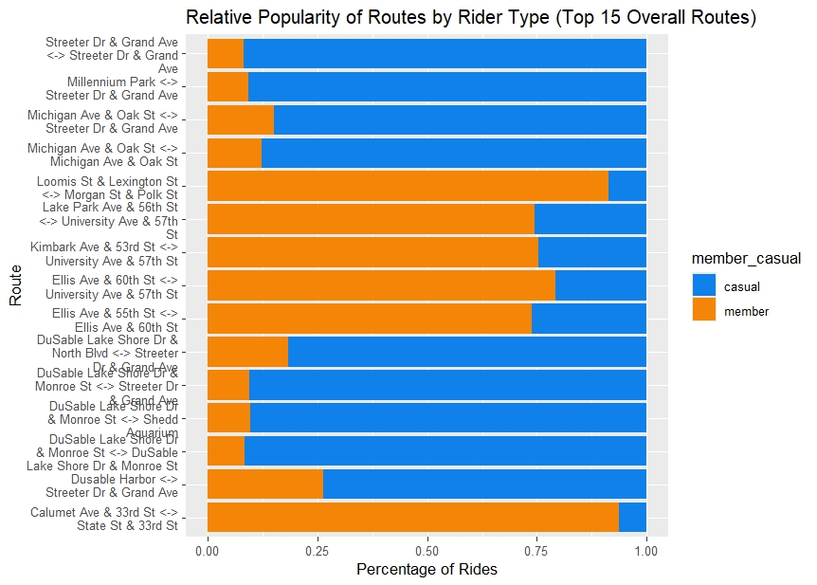
Analysis of Rider Types in Different Categories

Slide 13

Insights Gained
What do the difference uncovered mean for the business?

Slide 14
Insights
The majority of users are already members
As most users are already using the service, it can be said that most if not all marketing resources should go towards the casual riders.
Duration of Rides
The usage of Cyclistic is similar between members and casual riders, with the majority of both using it for rides lasting about 10 minutes.
Usage of Types of Rides
Both have a very similar usage of rides.
Usage of Specifically Electric Scooters
Most electric scooters rides were ridden by casual riders, indicating that casual riders would benefit the most from an increase in the overall number of electric scooters at stations.
Popular Routes are Dominated by Casual Riders
The overwhelming majority of the most popular routes overall are dominated by casual riders. Due to them being a minority overall, it makes sense that casual riders are concentrated amongst a few highly popular routes.

Slide 15
Business opportunities are like buses. There’s always another one coming.
“
”
Richard Branson
An Analysis on The Differences between Casual Riders and Members of Cyclistic

Slide 16
Recommendations for Converting Casual Riders into Members
Targeting Popular Routes in the Marketing Campaign​
Increasing the number of electric scooters
Increasing the number of bikes/scooters at close stations
Considering that there are over 1000 stations and even more unique routes, it would be more effective to target ads for casual riders at places where it can get the most reach for a single advertisement. Since the most popular routes are dominated by casual riders, most, if not all marketing should be targeted at these stations. ​
Since electric scooters are the only ride category that is dominated by casual riders despite there being very few electric scooter rides overall and the fact that only 30% of rides are by casual riders, it can be inferred with a great degree of confidence that there is a preference of electric scooters amongst casual riders. Increasing the number of these rides available at popular stations is likely to woo them into converting into annual members.
Since both casual riders and members often use Cyclistic for short trips, it makes sense that by increasing the availability of overall number of rides at stations that are 5-15 minutes of travel time within each other would increase the value perceived by casual riders in buying a membership. This can be used as an advertising point during the digital media marketing campaign as well.

Slide 17

Thank you
Harikeshav Shekar
shekarhari.ws@gmail.com
https://www.linkedin.com/in/harikeshav-shekar

